Slide 1
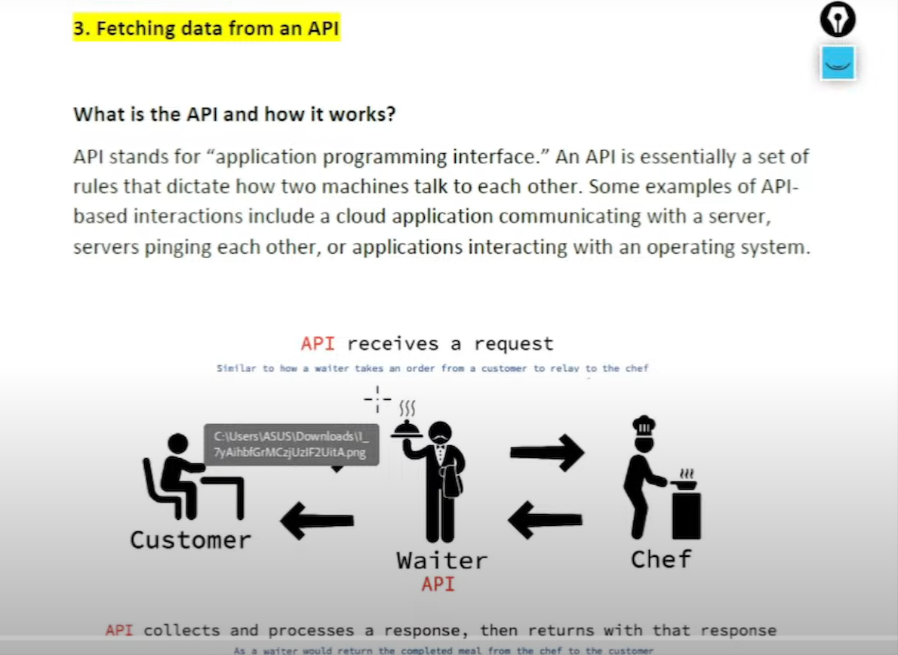










Slide 2
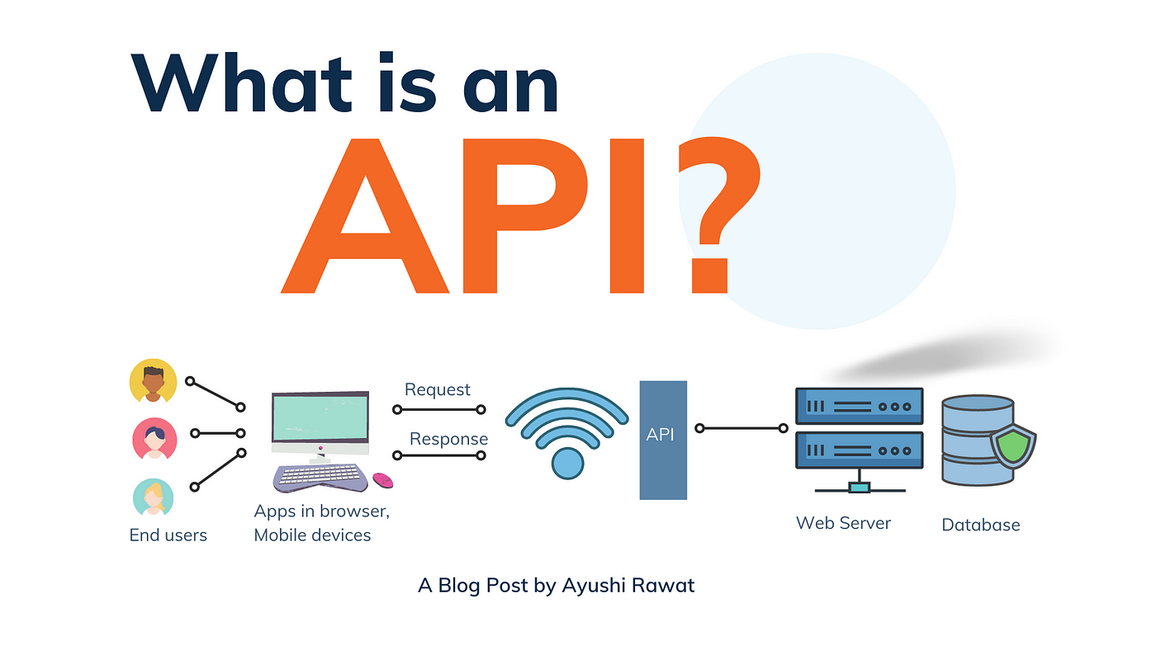











Slide 3

Website we use for fetching API
TMDB: https://www.themoviedb.org/
TMDB API: https://developer.themoviedb.org/reference/movie-top-rated-list
Generate API Key after login and Paste in this link for JSON File
https://api.themoviedb.org/3/movie/top_rated?Api_key=5afda766e740b8ae5403dde7733b5b35&language=en-US&page=1
https://api.themoviedb.org/3/movie/top_rated?api_key=5bc643f664c8c66e7edce11b77c7214e&langage=en-US&page=1
Use tool for understand the JSON File: https://jsonviewer.stack.hu/
https://api.themoviedb.org/3/movie/top_rated?language=en-US&page=1"
Our objective: we want to create data set in python where row and column
8974 * 6
ID | Title | Realised Date | Overview | Popularity | Vote average

Slide 4




















Slide 5





